Slide 1
Development of B Lymphocytes
Prof Nizar Abuharfeil

Slide 2
Lecture outline
Developmental stages of B cells
Stem, Pro and pre B cells
Description of self-tolerance in Immature B cells
Describe the surface markers of mature b cells.
Events in germinal centers
B-1 and B-2 cells

Slide 3
Development of B Lymphocytes
Primary lymphoid organ: for B cell differentiation
Birds: Bursa of Fabricius responsible for Ab synthesis
Mammals: no Bursa but bursa-equivalent
early fetal development: liver
later fetal dev. and after birth: bone marrow
CD nomenclature: cell surface molecules
Each stage of B cell diff. are characterized by the expression of different CD molecules

Slide 4
Stem cells
B cells arise from hematopoietic stem cells HSCs
Interaction with the BM stroma (nonlymphoid cells) and the action of cytokines (IL-7) signals promote development of B cells
HSCs are a rare cell population, with only around 1 in 2,000-10,000 BM cells.
The self-renewal potential of human HSCs is what makes their clinical application so promising. Markers The lin⁻/CD34⁺/CD38⁻/CD45RA^{−.} CD34 is the most critical marker
Pro-B:
-shows the first rearrangement of Ig genes at heavy chain locus. D_{H}-J_{H}
  -Express CD19 that is expressed in all stages except plasma cell (useful marker)
  -Express CD10 (in pro and pre-B cells) only

Slide 5
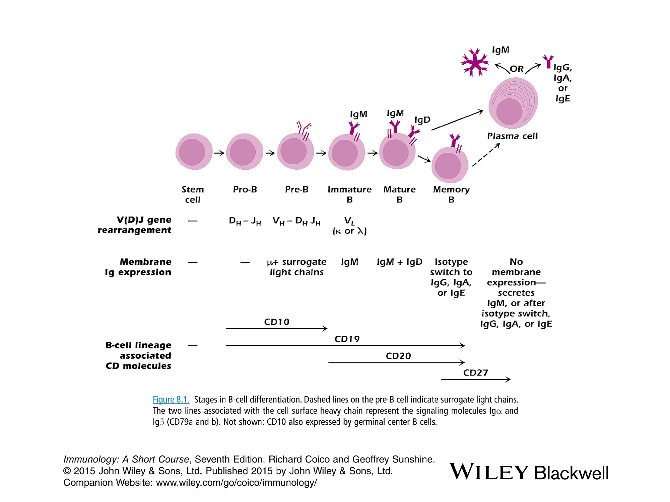

Slide 6
Pre-B cells
VH gene segment rearrange to join the D_{H}-J_{H} forming V_{H}-D_{H}-J_{H} put close to Cμ.
Express the μ chain as a transmembrane molecule in conjunction with 2 nonrearranging genes called λ5 and V_{preB} (surrogate L chain)
Expression of 2 associated transmembrane molecules (Igα and Ig β) linked by S-S bond.
function in signal transduction
noncovalently associated with Ig H and l chains to form Pre-BCR
Allelic exclusion occurs
Express CD10 (marker for early stages) and CD19

Slide 7
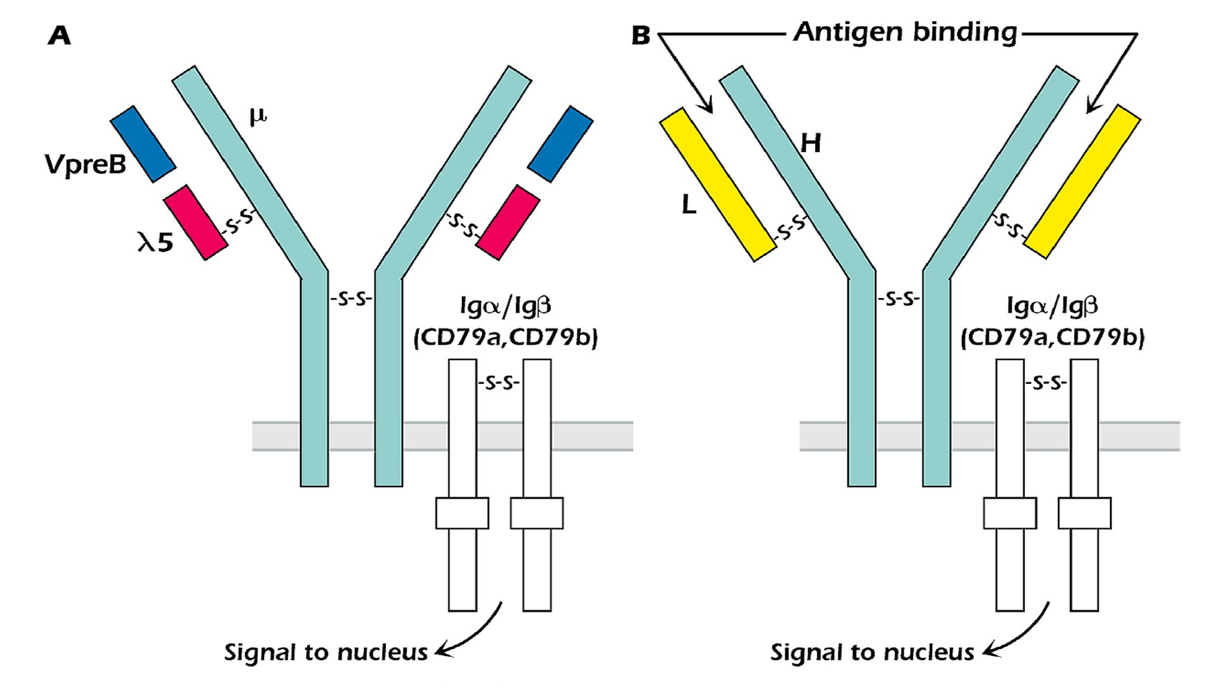

Slide 8
Immature B cells
L chain will pair with μ chain to form monomeric IgM inserted in the membrane.
Express CD20 (a marker for later stages of B cell development).
Interaction with nonself Ag results in anergy or inactivation
Deletion of self-reactive B cells is called ‘negative selection” a critical feature of self or central tolerance.

Slide 9
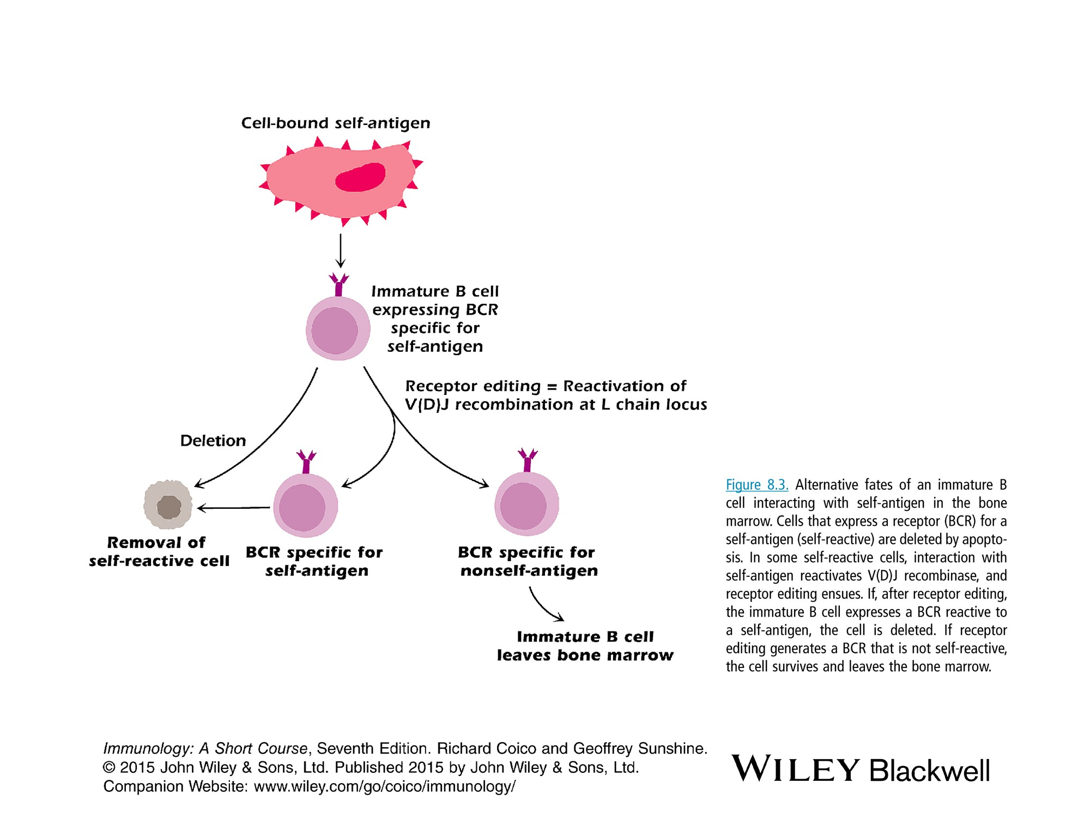
Receptor editing occurs primarily in the L chain because, after V_{H}D_{H}J_{H} recombination in the Igh locus is completed, there are rarely any D_{H} gene segments available to permit further rearrangements satisfying the structural rules of V(D)J recombination.
Self Soluble Ag
2’
Anergy
1
2

Slide 10
Mature B cell membrane proteins
BCR: Membrane IgM and IgD
Signal transduction molecules: Igα and Ig β
B cell coreceptor: CD19, 81 and 21
function to reduce the threshold of B cell activation in response to an Ag needed to stimulate an Ab response 100-1000 times
Molecules involved in T-B cell interaction
-express MHC class I and II
.-express the following costimulatory molecules required to activate naïve T cells:
B7 (enhance stimulation),
CD40 (class switching),
(ICOSL) Inducible costimulatory ligand formation of germinal centers

Slide 11
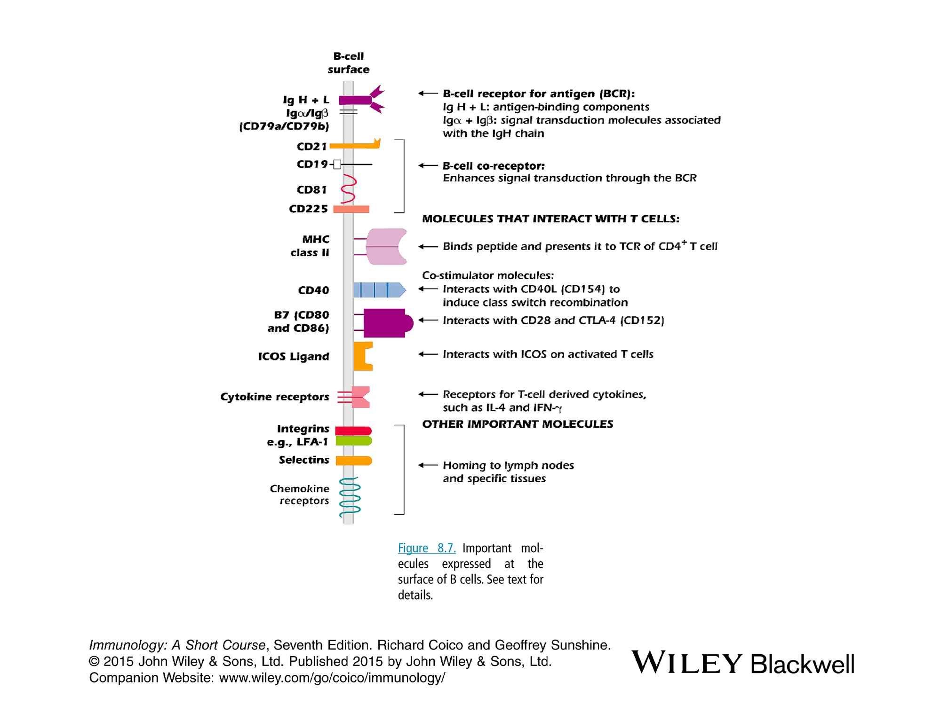

Slide 12
Mature B cells
Membrane IgM and IgD expressed on the same B cell results from alternative splicing.
Interaction with nonself Ag results in activation
A large repertoire of Ag specificities are generated to guarantee a response to any Ag that a person may encounter.
Very young children may lack B cells specific for some bac Ags but these B cells develop by about 2 years of age.
Most mature B cells do not interact with Ags during their life time but remain as resting unstimulated (naïve) IgM IgD cells.

Slide 13
Plasma cells
Activation of mature B cells by Ag results in formation of plasma cells that is responsible for Ab synthesis
An individual plasma cell secretes Ab of a single Ag specificity (the same as Ig on the surface)
Does not express membrane Ig
Does not express CD10, 19, 20, MHC
Generated in the germinal centers of lymph nodes and spleen
Plasma cells produced in peripheral L.nodes (outside the mucosa) migrate primarily to the b.m. where they may live for years

Slide 14
Memory B cells MBC
After Ag activation, few B cells develop ino MBCs
Are nonproliferating, long-lived for secondary immune response.
Express IgG isotypes other than IgM. IgD and IgE are rare
Express CD27 (used for identification). MBCs that lack CD27 are generally associated with exhausted B cells
The receptor CCR6 is generally a marker of B cells that will eventually differentiate into MBCs.
They do not produce Abs, unless re-exposure to Ag drives their differentiation into Ab producing plasma cells.
the MBC does not need to have continual interaction with the Ag nor with T cells in order to survive long-term.
Naive B cells undergo limited differentiation when co‐cultured with monocytes alone compared to monocytes and T cells, whereas MBC differentiation is enhanced when T cells are lacking
They leave the lymphoid organs and move into tissues in contrast to naïve cells

Slide 15
Events in the germinal centers
Germinal center: develop in the B cell follicles of secondary lymphoid tissues during T cell-dep (TD) Ab responses.
Dark zone: area with Ag-activated B cells: 3 crucial events occur
somatic hypermutation to develop affinity maturation
Class switch recombination
Development of plasma and memory B cells
Mantle zone: Ag-nonspecific move out
Light zone: Following somatic hypermutation, B cells enter light zone where they interact with specific CD4+T cells and follicular dendritic cells: immune response.

Slide 16
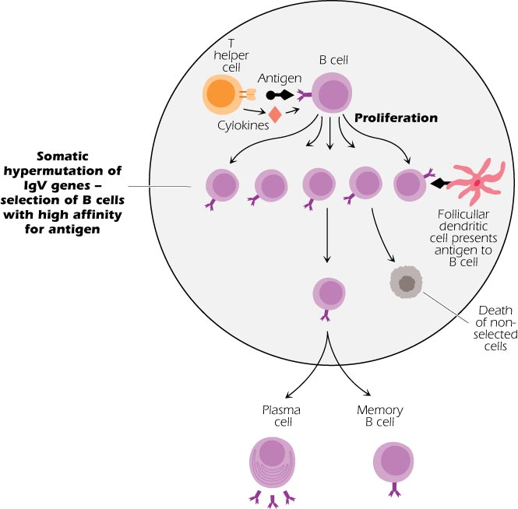

Slide 17
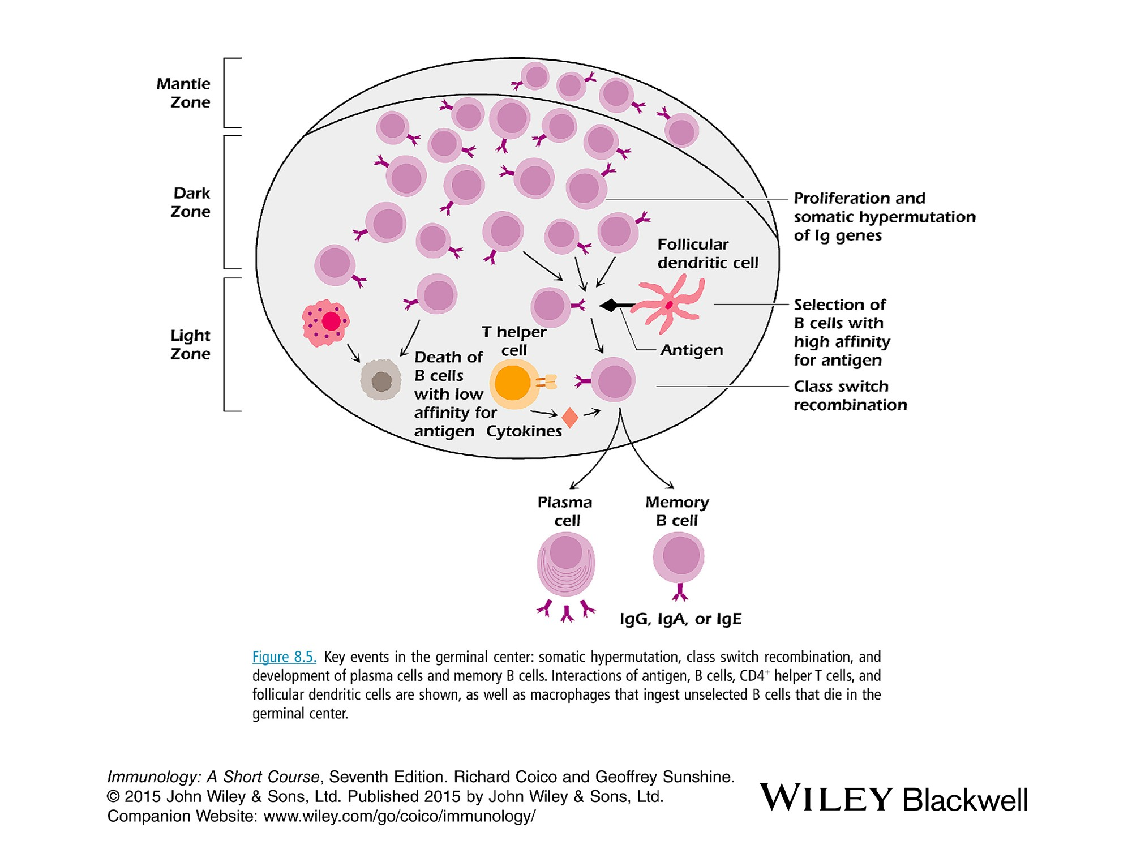

Slide 18
B-1 cells
Subpopulation of B cells predominate in the peritoneal and pleural cavities but minor in spleen and L. nodes.
Synthesize low affinity IgM early in the T-independent primary response to many Ags.
Responsible for most of nature Abs in the absence of Ag priming. So they are the first line of defense against systemic bac and viral infections.
Use a limited set of v gene segments to form their repertoire
Characterized by the surface expression of CD5 (predominate in chronic lymphocytic leukemia)

